Slide 1
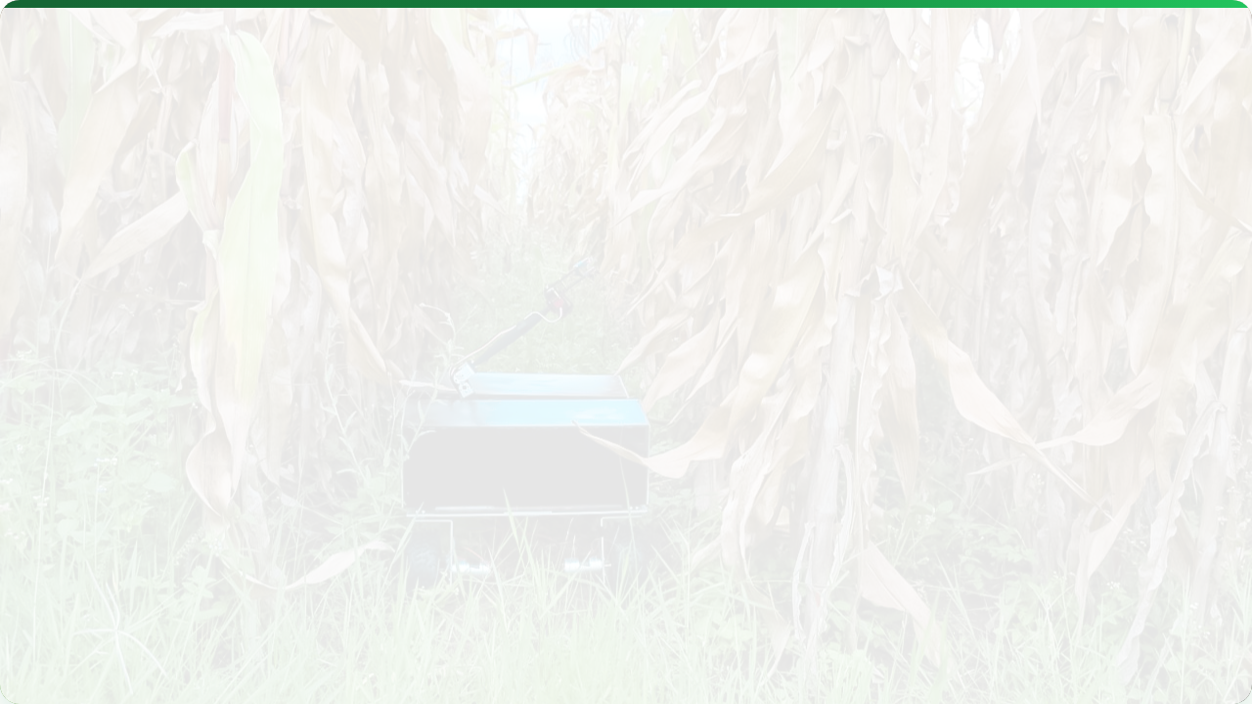



DECISION SUPPORT SYSTEMS (DSS) & AI
Lecture 11: From Data to Wisdom
AGE 418
Dr. Kadeghe Fue

Slide 2




Lecture Roadmap
Foundations
Innovation
What is a DSS?
AI & Machine Learning
The 4-Component Model
Predictive Modeling
Crop Simulation (DSSAT/APSIM)
Case Studies: LimaBot, Ushauri, Farmonaut (Tanzania)

Slide 3


What is a DSS?
Decision Support System (DSS): An interactive software-based system intended to help decision-makers compile useful information from raw data to solve problems.
In Agriculture, it answers the "What If?" questions.
"What if I plant 2 weeks later?"
"What if I reduce Nitrogen by 10%?"

Slide 4





The Goal: The 5 R's
DSS tools are designed to achieve Precision Agriculture's core mission:
Right Input
Right Time
Right Place
Right Amount
Right Manner

Slide 5





Components of a DSS
A holistic DSS integrates four key elements:
Weather: Historical and Forecast data.
Crop: Genetic coefficients and phenology.
Centred on the Model
Analyze: The algorithms (The "Black Box").
Access: The User Interface (Dashboard/App).

Slide 6


Virtual Farming
Crop Simulation Models are computer programs that mathematically simulate crop growth and development day-by-day.
We "grow" the crop in the computer before we plant it in the field.
DSSAT
APSIM
Decision Support System for Agrotechnology Transfer.
Agricultural Production Systems sIMulator.

Slide 7
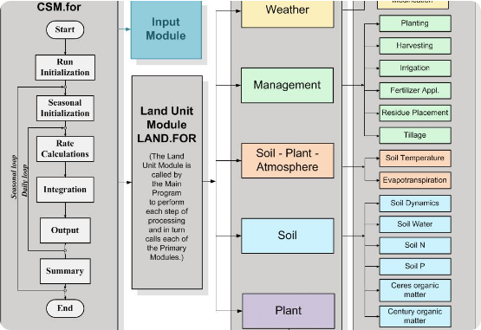
Spotlight: DSSAT
Developed in the USA, widely used globally.
Simulates growth of 42+ crops (Maize, Wheat, Rice, Beans).
Inputs: Soil profiles, Weather files, Management (Fertilizer dates).
Outputs: Yield, Biomass, Nitrogen Leaching.

Slide 8
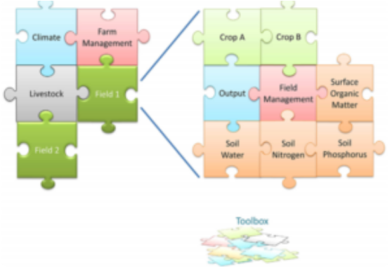
Spotlight: APSIM
Originally from Australia. Strong focus on farming Systems.
Excellent for crop rotations and intercropping.
Tracks soil water and nitrogen over many years.
Modular: You can "plug in" different crop modules.

Slide 9
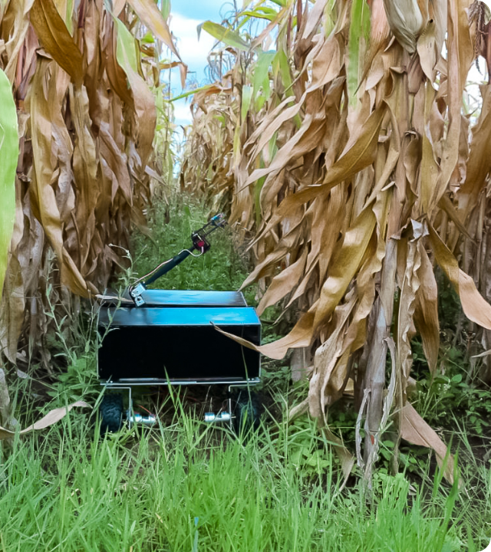
Case Study: Wami-Ruvu
Research: Calibrating DSSAT for Maize in Tanzania.
Researchers collected local soil and weather data to "teach" DSSAT how Tanzanian maize varieties grow.
Result: The model successfully predicted yields under rainfed conditions.
Impact: We can now use this calibrated model to test climate change scenarios for Morogoro region.

Slide 10


From Simulation to AI
Simulation (Old)
Artificial Intelligence (New)
Uses biological equations.
"If temp < 10°C, growth = 0"
Uses Data Patterns.
"Historical data shows when X happens, Yield is Y."
Requires perfect understanding of physiology.
Finds hidden correlations in massive datasets.

Slide 11





AI Applications
Yield Prediction
Disease ID
Robotics
Using satellite history + weather to forecast harvest volume.
Computer Vision (CNN) to identify pests from photos.
Autonomous navigation and weed recognition.

Slide 12
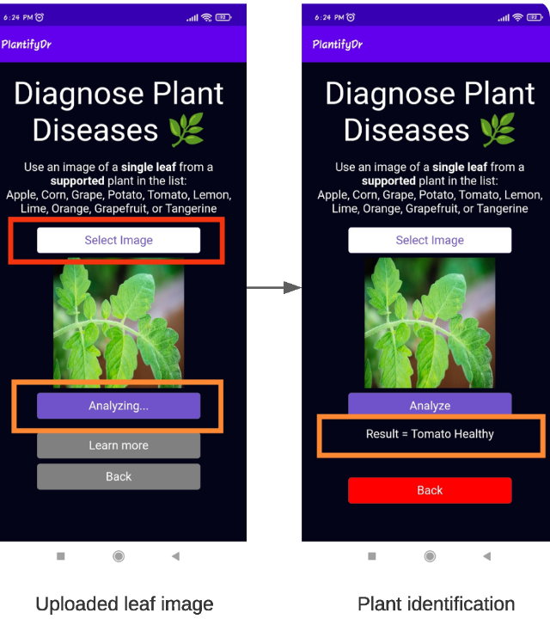
TZ Innovation: LimaBot AI
"Dr. in your Pocket"
Function: Crop disease diagnostics via WhatsApp/App.
Tech: AI analyzes photos of sick leaves submitted by farmers.
Output: Instant diagnosis and treatment advice in Swahili.
Impact: Reduces crop loss for smallholders lacking access to extension officers.

Slide 13

Case Study: "Ushauri"
Digital Advisory Service
Developed to bridge the gap between researchers and farmers in Tanzania.
Mechanism: Automated hotline (IVR) and SMS.
Content: Pre-recorded expert advice on agronomy.
Data: Tracks what questions farmers are asking to guide future research.

Slide 14

Future Trends
Edge AI
Integration
Blockchain
Processing data on the device (no internet needed). Crucial for rural Tanzania.
Connecting market price data with yield prediction to optimize selling time.
Securing farm data ownership and traceability.

Slide 15


Lecture Summary
DSS
AI & Local Tech
Tools like DSSAT and APSIM allow us to simulate scenarios before risking capital.
Innovations like LimaBot and Ushauri are bringing high-tech decision support to smallholder farmers via mobile phones.
Next Class: Lecture 12 - Precision Irrigation

Slide 16

Questions?
Dr. Kadeghe Fue | AGE 418
Sokoine University of Agriculture

